Slide 1

Final presentation
S-IoT Project
Siméon Gass
Côme Le Briéro

Slide 2

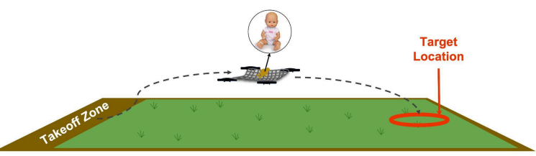
Context
Automated Drone Competition, Outdoor Competition Mission 3
3 drones carrying a 3kg load

Slide 3
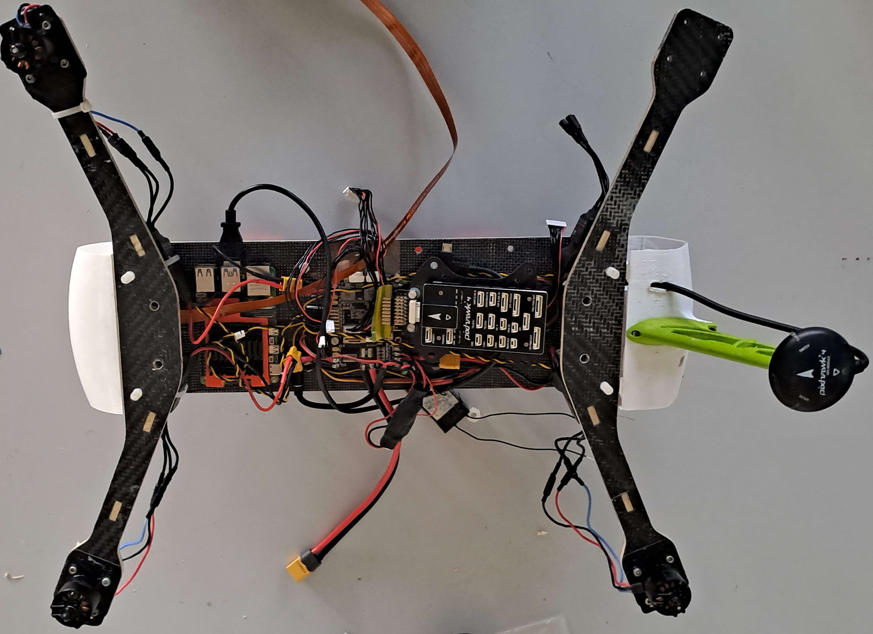
Drones
Carbon Fiber
Motors / ESC
Flight Controller
Raspberry Pi
GPS

Slide 4

Challenges
Safety: Avoid crashes
Precision
Precise measurements, reliable communications and robust control law

Slide 5
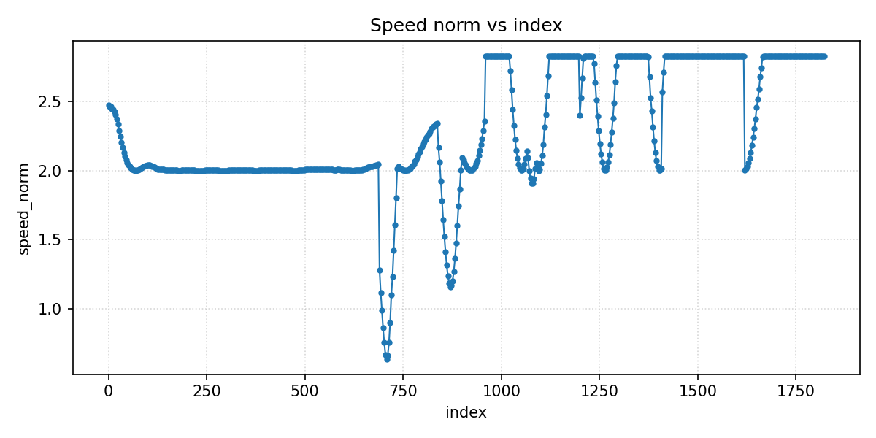
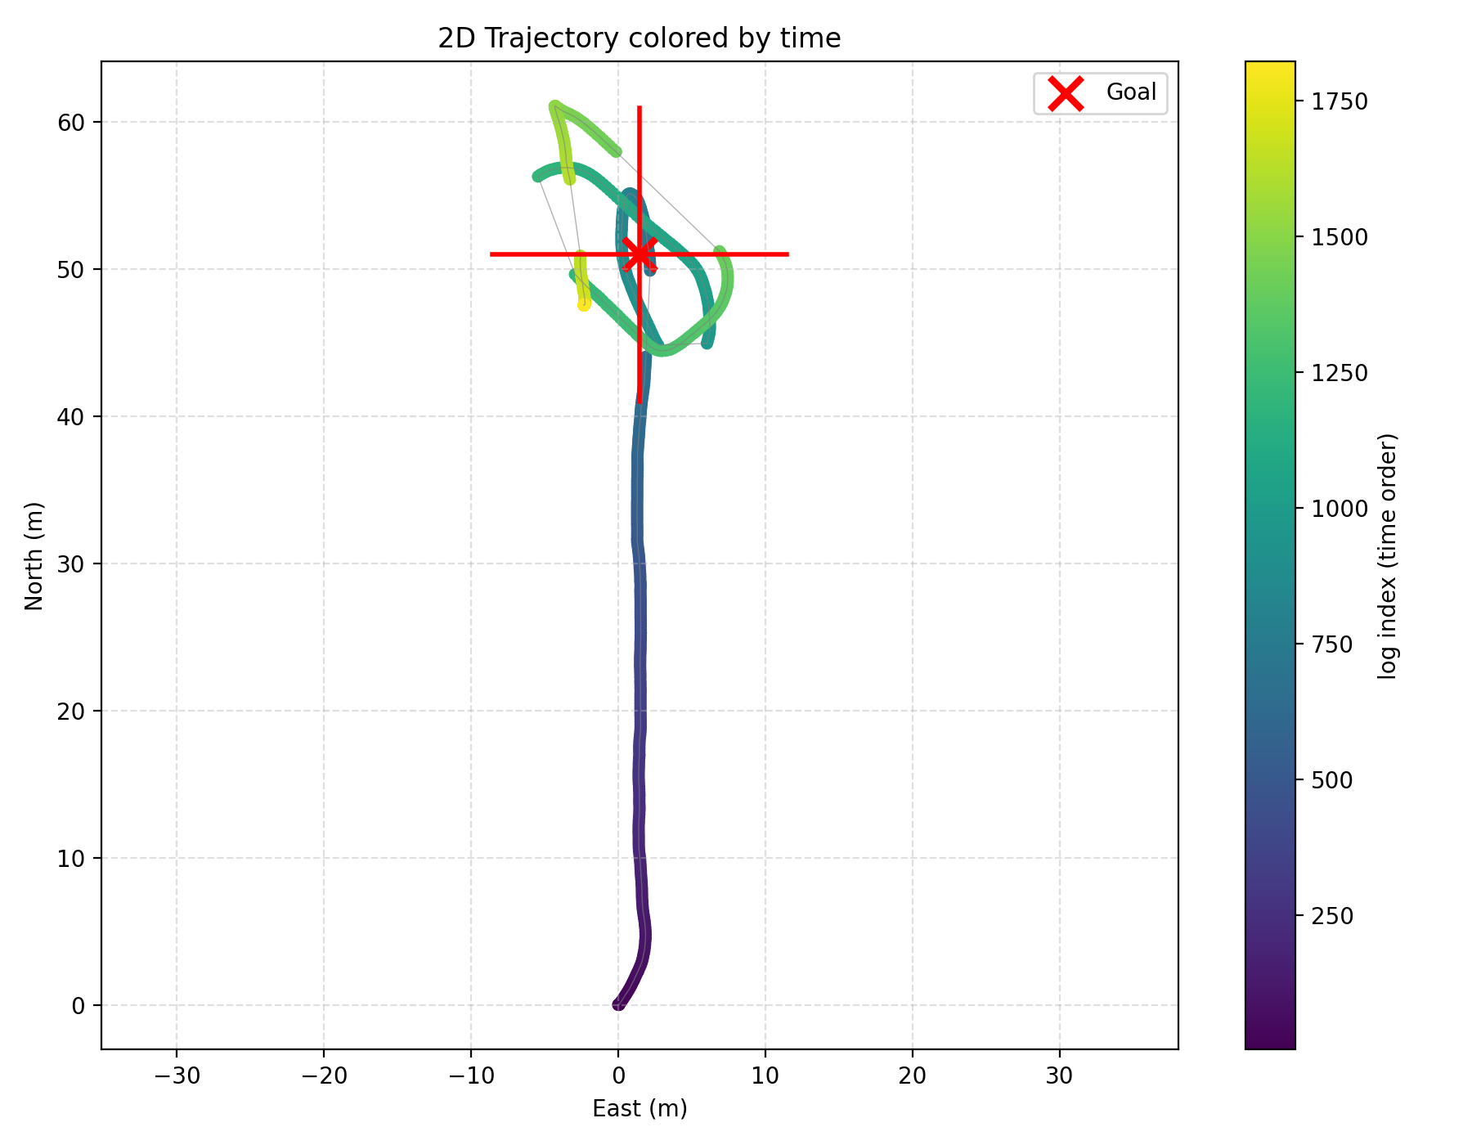
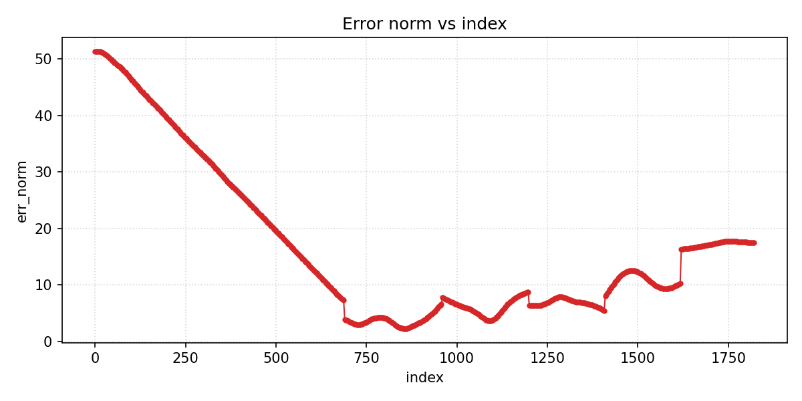
Controller test

Slide 6
Relative positioning techniques
GPS
UWB
LIDAR
Vision
Ultrasound
Wi-Fi

Slide 7
UWB
T
A
A
A
A

Slide 8
In our case
D2
Leader
D1
Followers
D3

Slide 9
In our case
Anchor
Anchor
D1
D1
D2
D3
D2
D3
Anchor
Tag + Anchor
Tag + Anchor
Tag + Anchor

Slide 10
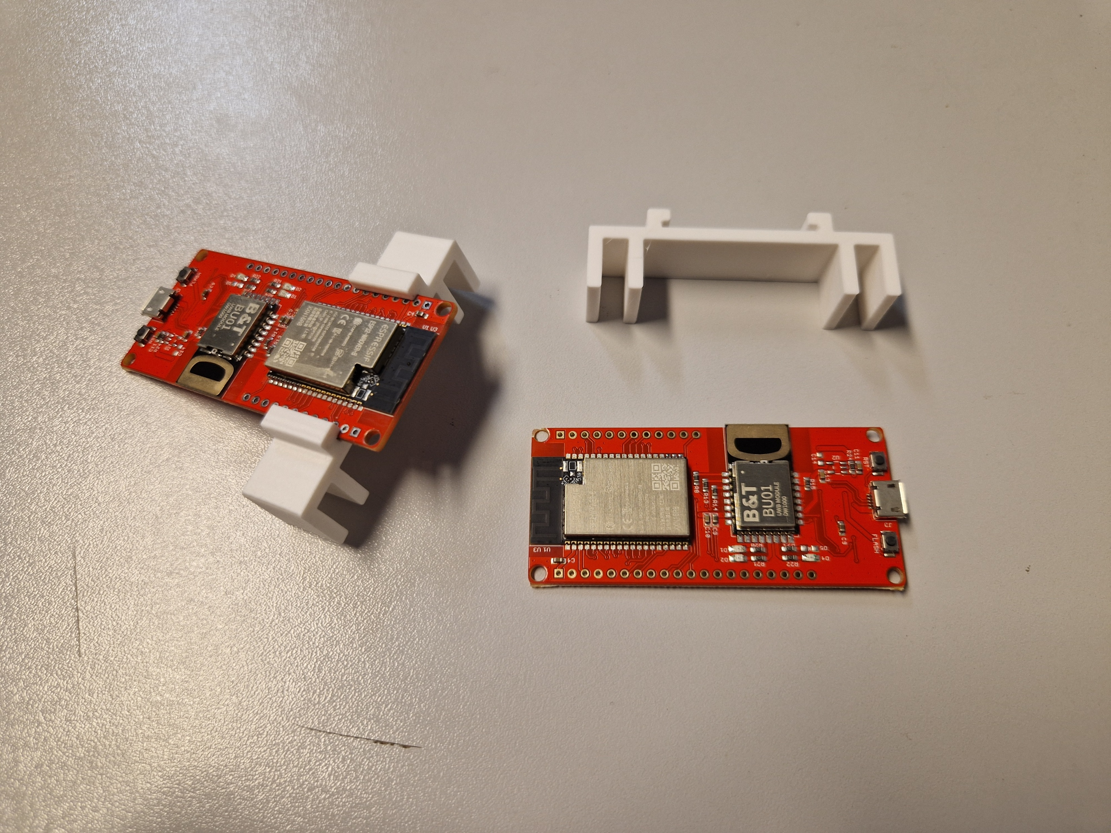
3D printed support

Slide 11
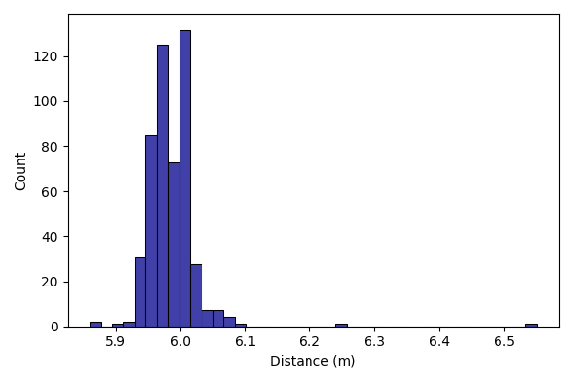
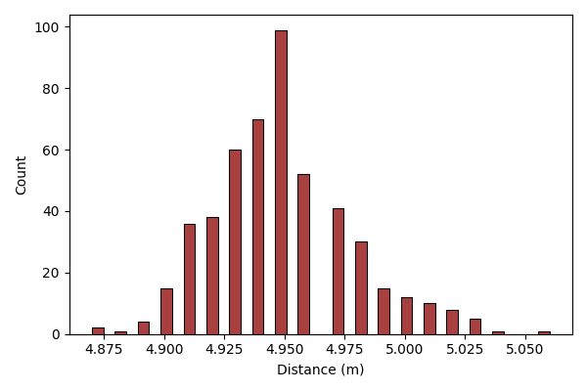
Antenna radiation test

Slide 12
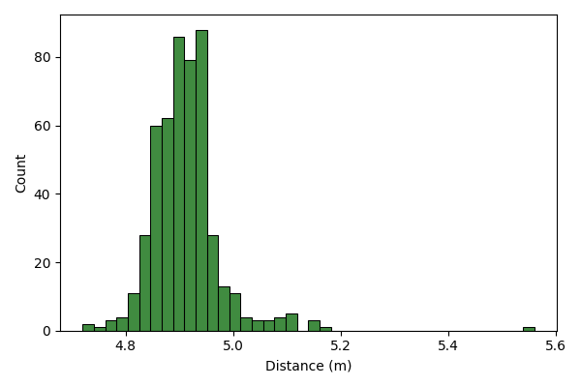
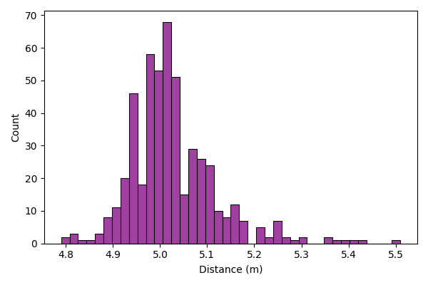
Antenna radiation test

Slide 13
Antenna radiation test
 | config 1 | config 2 | config 3 | config 4
Minimum | 5,86 | 4,87 | 4,72 | 4,79
Maximum | 6,55 | 5,06 | 5,56 | 5,51
Average | 5,99 | 4,95 | 4,91 | 5,03
Median | 5,99 | 4,95 | 4,9 | 5,01
Variance | 0,0016 | 0,0008 | 0,0045 | 0,0086
Standard deviation | 0,040 | 0,029 | 0,067 | 0,093
Range | 0,69 | 0,19 | 0,84 | 0,72
RMSE | 0,042 | 0,059 | 0,112 | 0,096

Slide 14
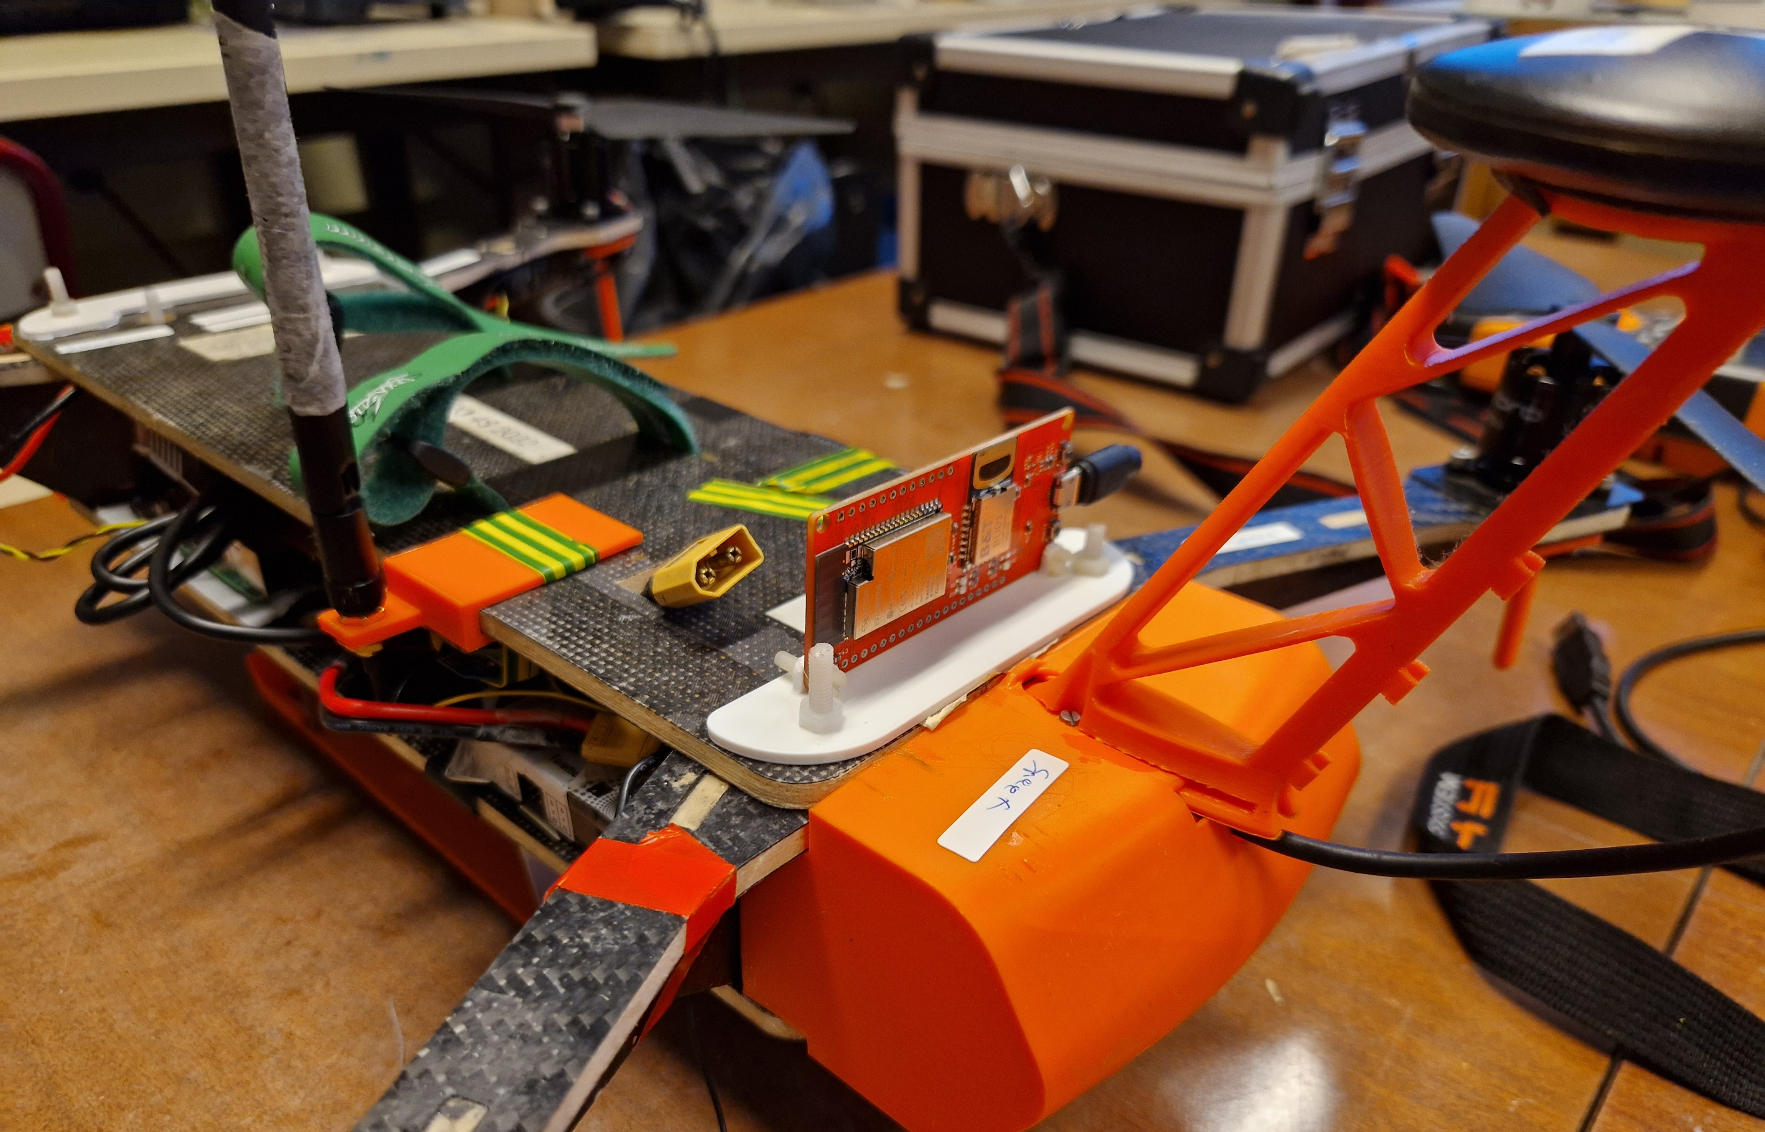
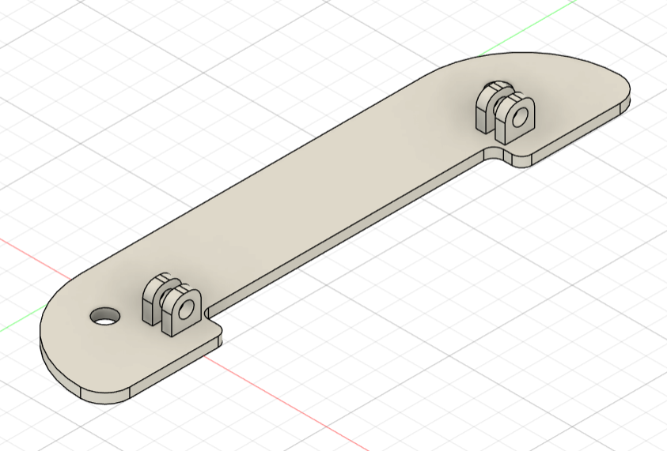
3D printed support

Slide 15
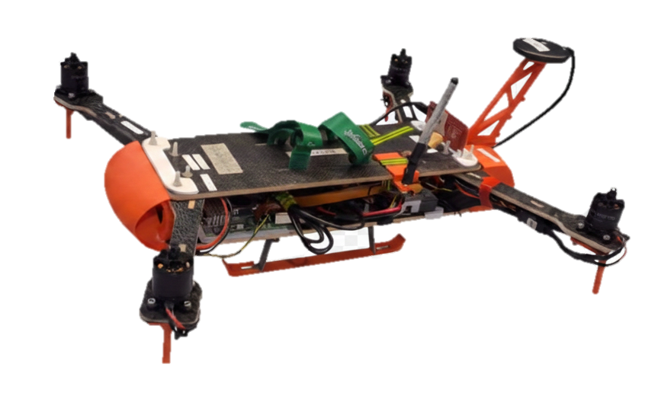
Flight test

Slide 16
Conclusion
Module auto-calibration
First UWB flight
What’s next:
Fix UWB loss of communication
Have a working communication between the drones

